Slide 1
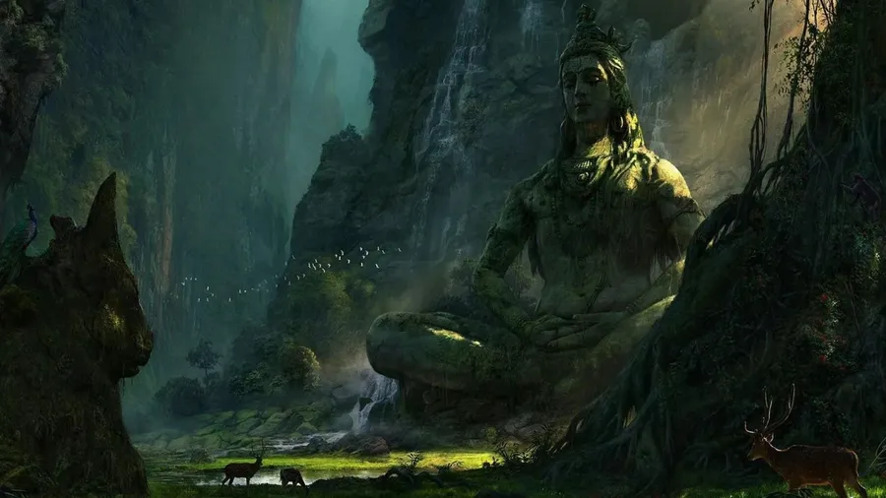
CG ART III
Lumenfall
Azra Tekin 309044

Slide 2
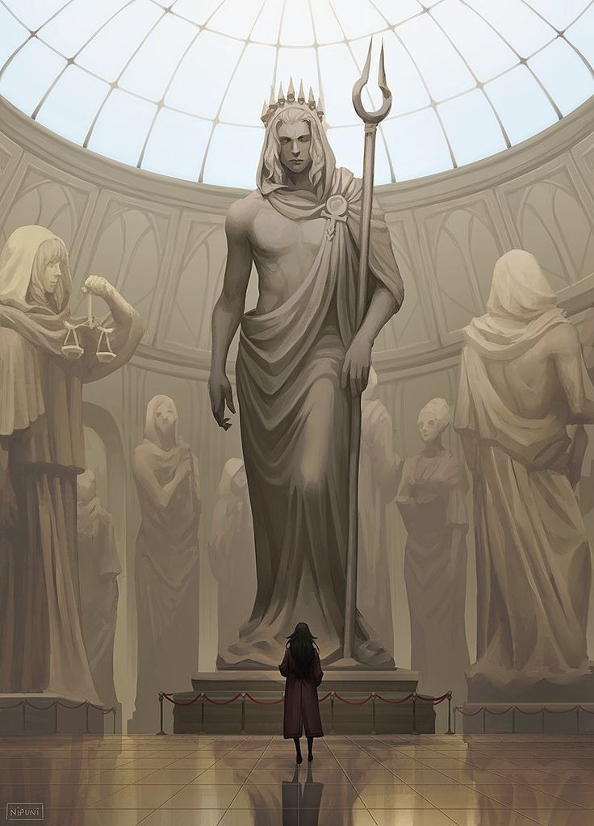
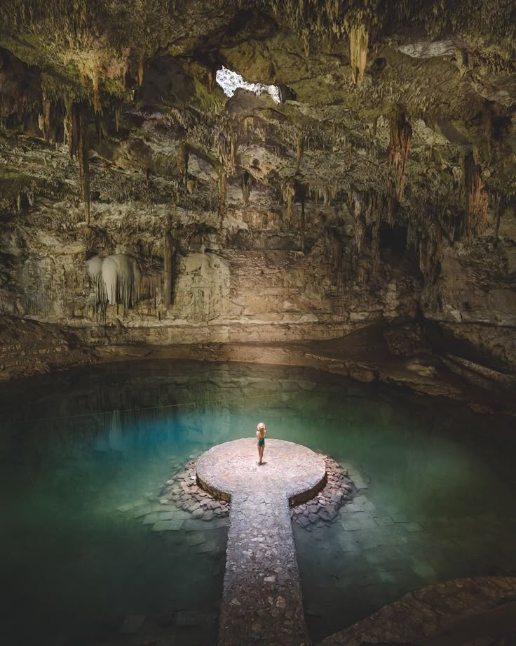
Concept
My concept will be an underground cave environment with a statue in the middle. I want to capture a large underground gazebo with benches around the statue. This cave can be entered through one way and brings you to the ruined gazebo. The cave will have lots of greenery and waterfalls flowing down the cave hole. The statue will be standing on a cut piece of pillar.
To make the view more dramatic I plan to have god rays coming from the hole in the cave at the top, to highlight its importance in the scene.
Notes:
What are your making?
Why are you making it (what draws you to the subject matter)
What are you looking to learn from it (what techniques are you exploring, pushing yourself to learn)

Slide 3
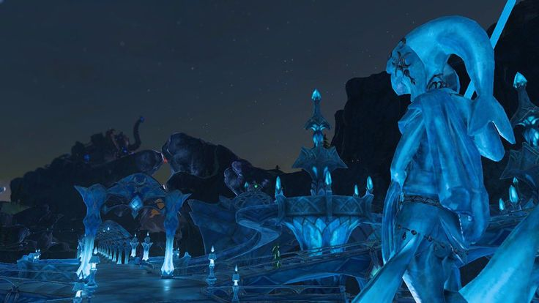
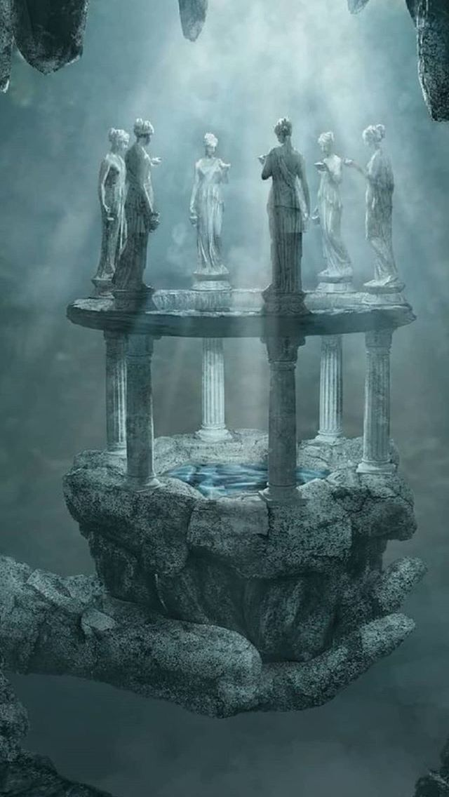
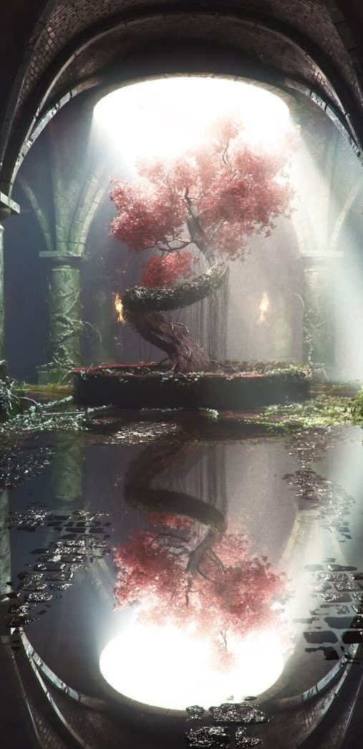
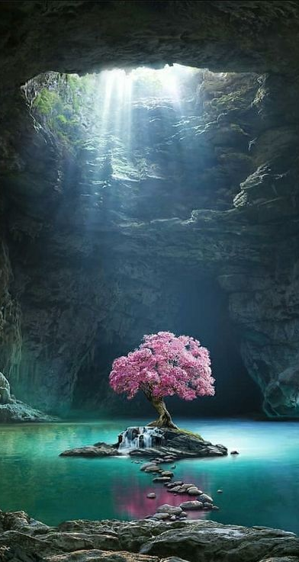
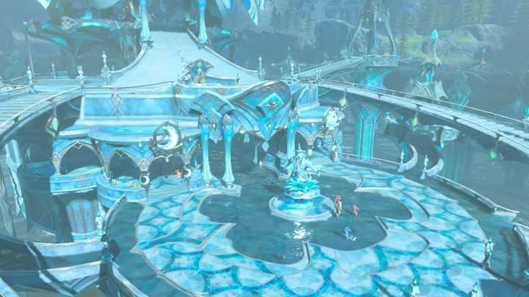
Moodboards - Environment
Notes:
Images you find or sketches you do.
Also write your reasoning.

Slide 4
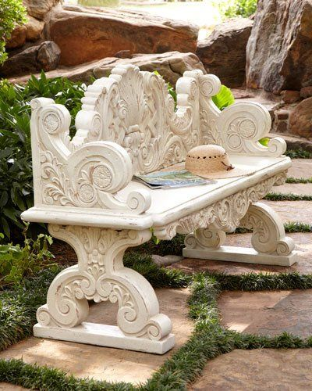
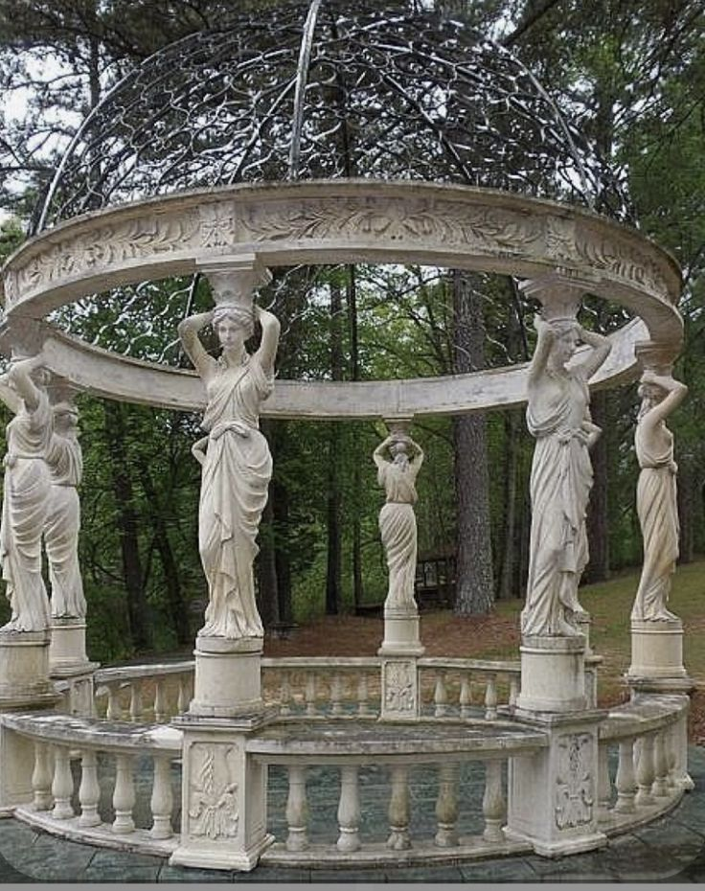
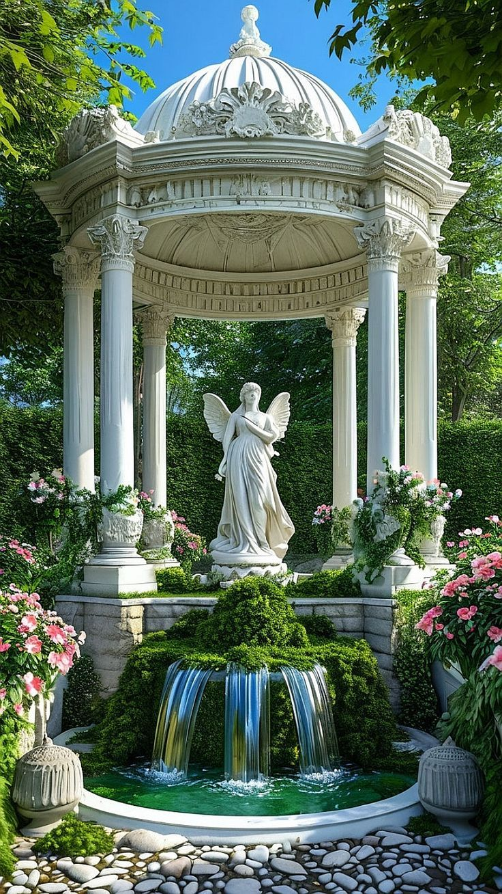
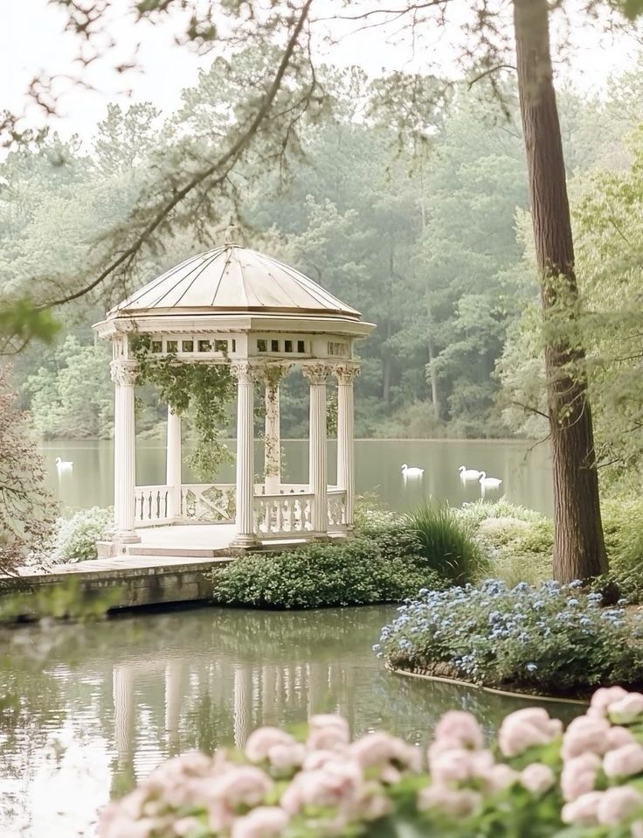
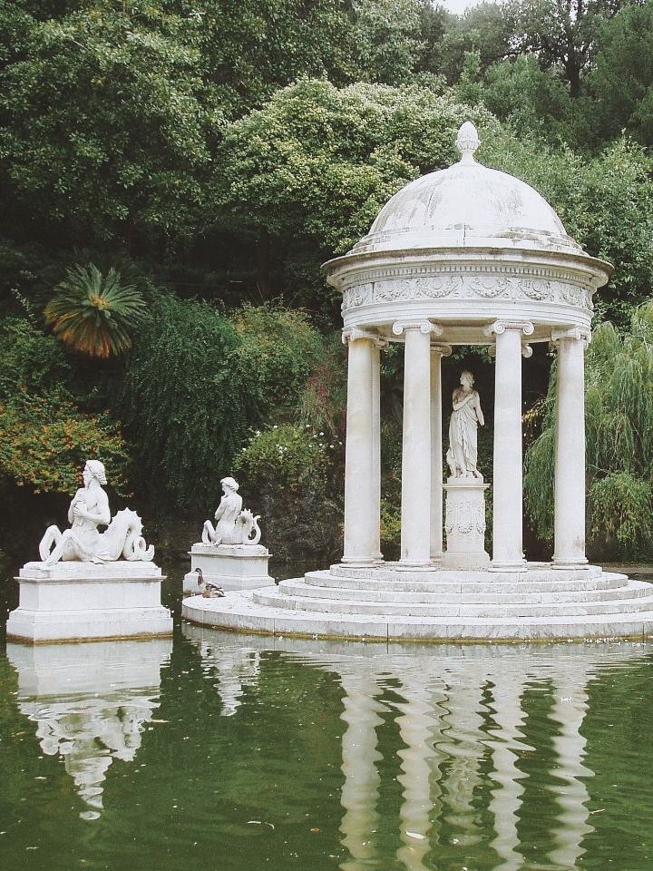
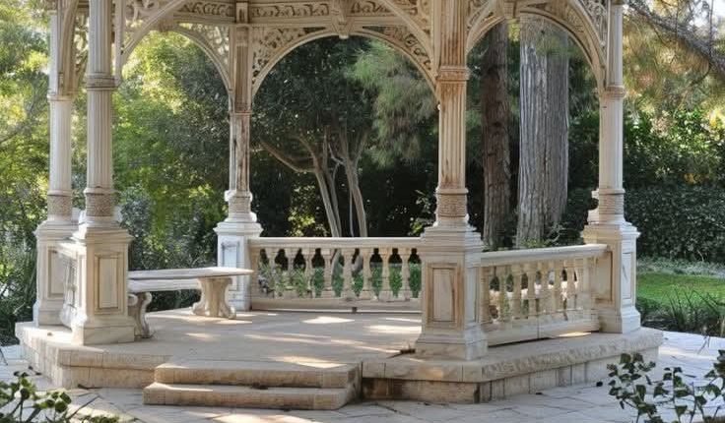
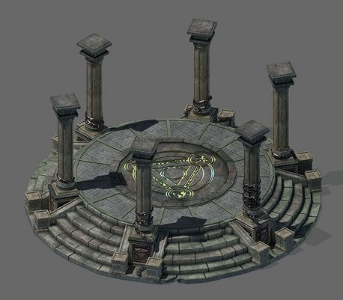
Moodboards - Props
Notes:
Images you find or sketches you do.
Also write your reasoning.

Slide 5
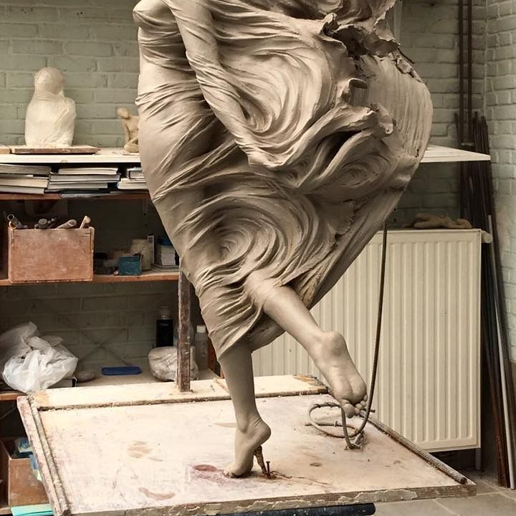
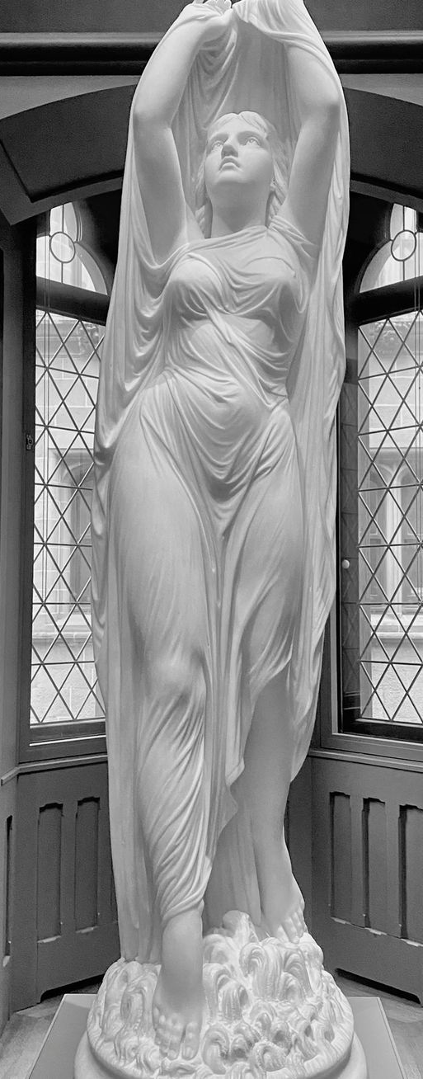
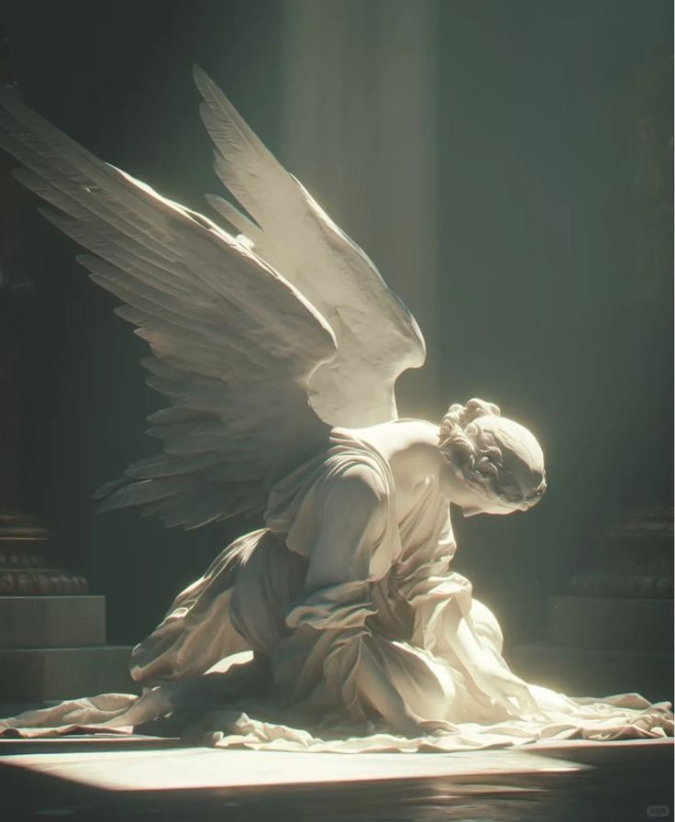
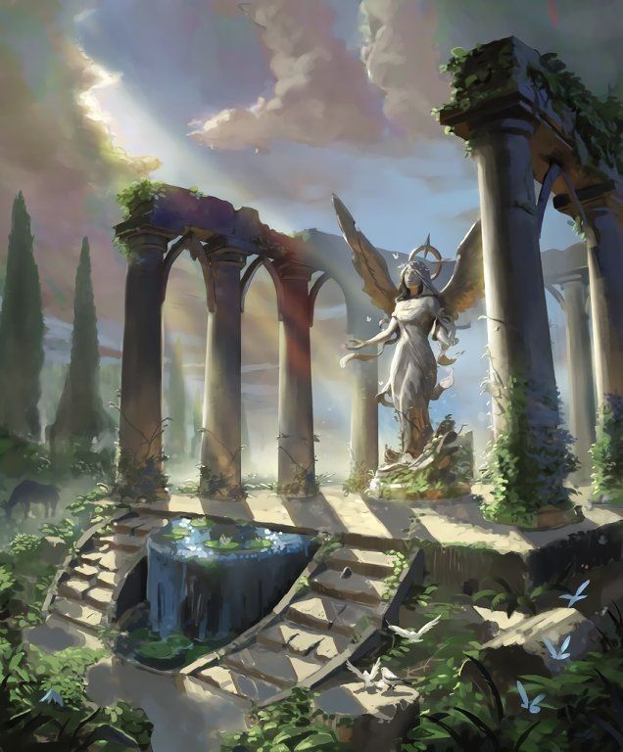
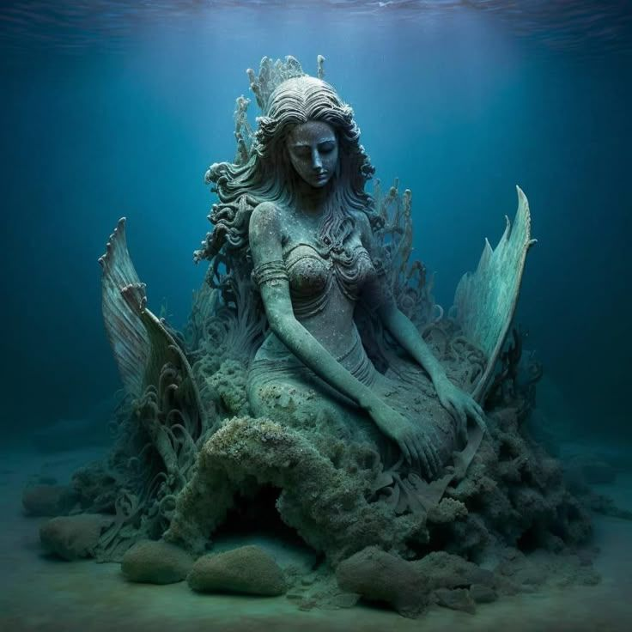
Moodboards - Main Subject
Notes:
Images you find or sketches you do.
Also write your reasoning.

Slide 6
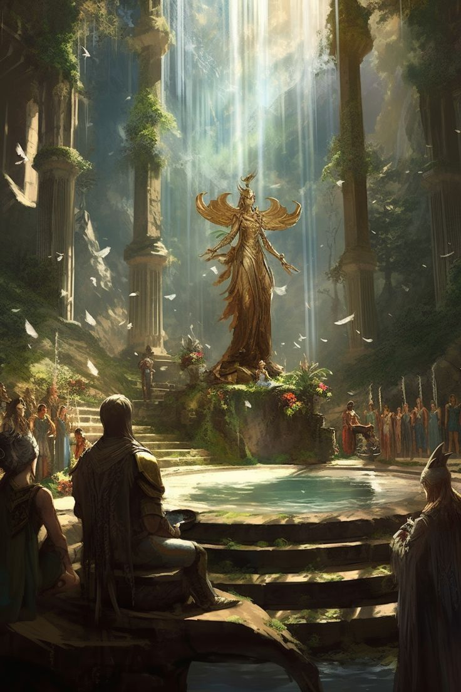
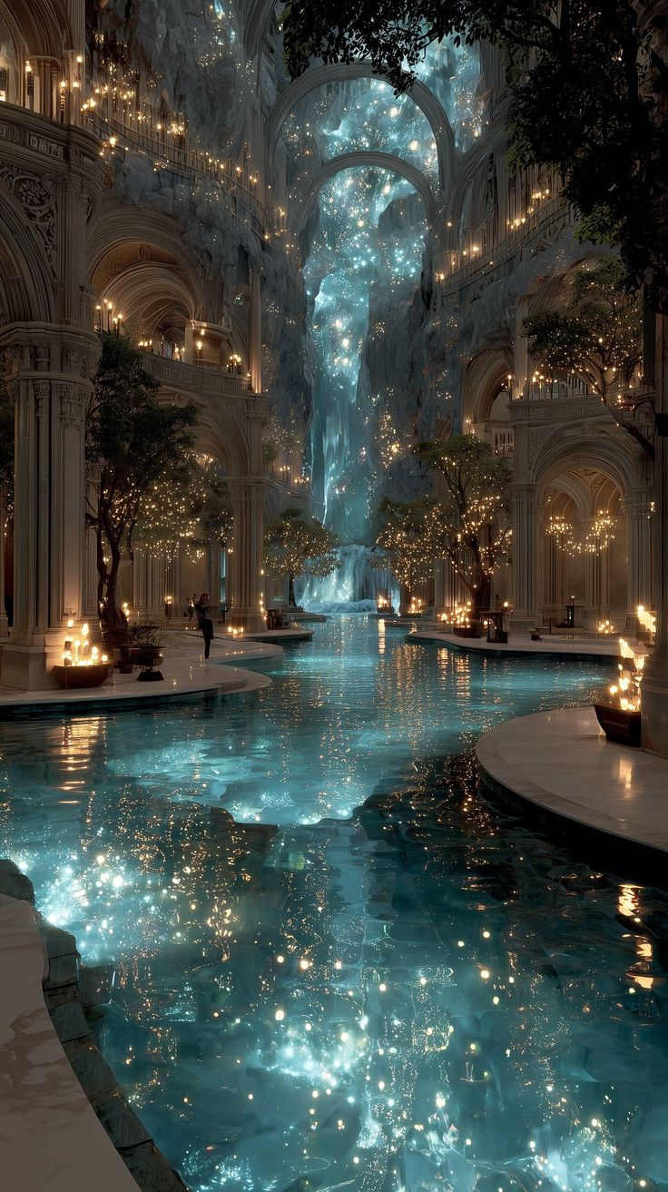
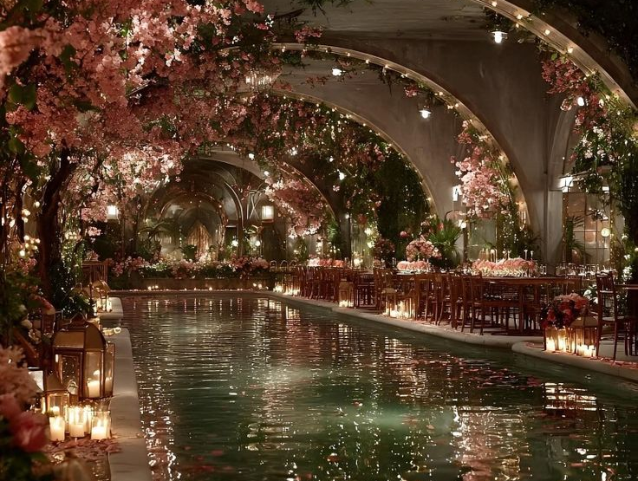
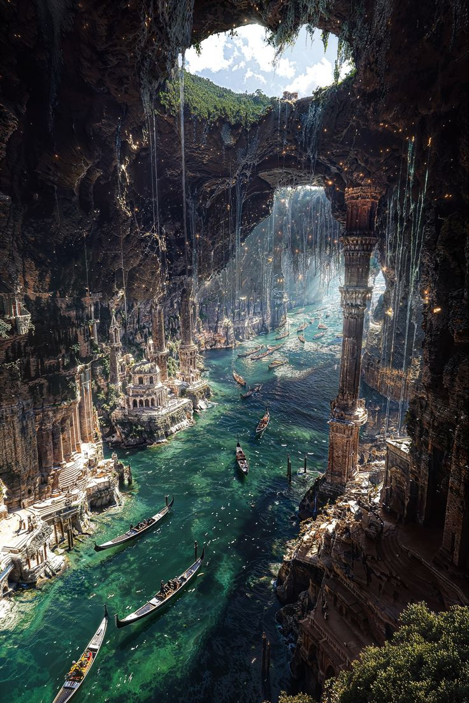
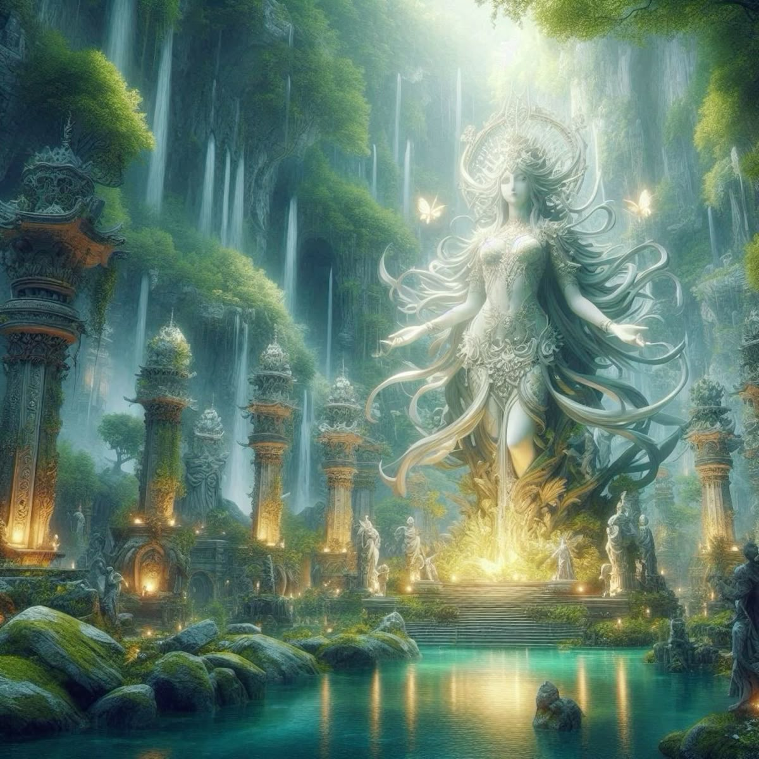
Moodboards - Lighting
Notes:
Images you find or sketches you do.
Also write your reasoning.

Slide 7
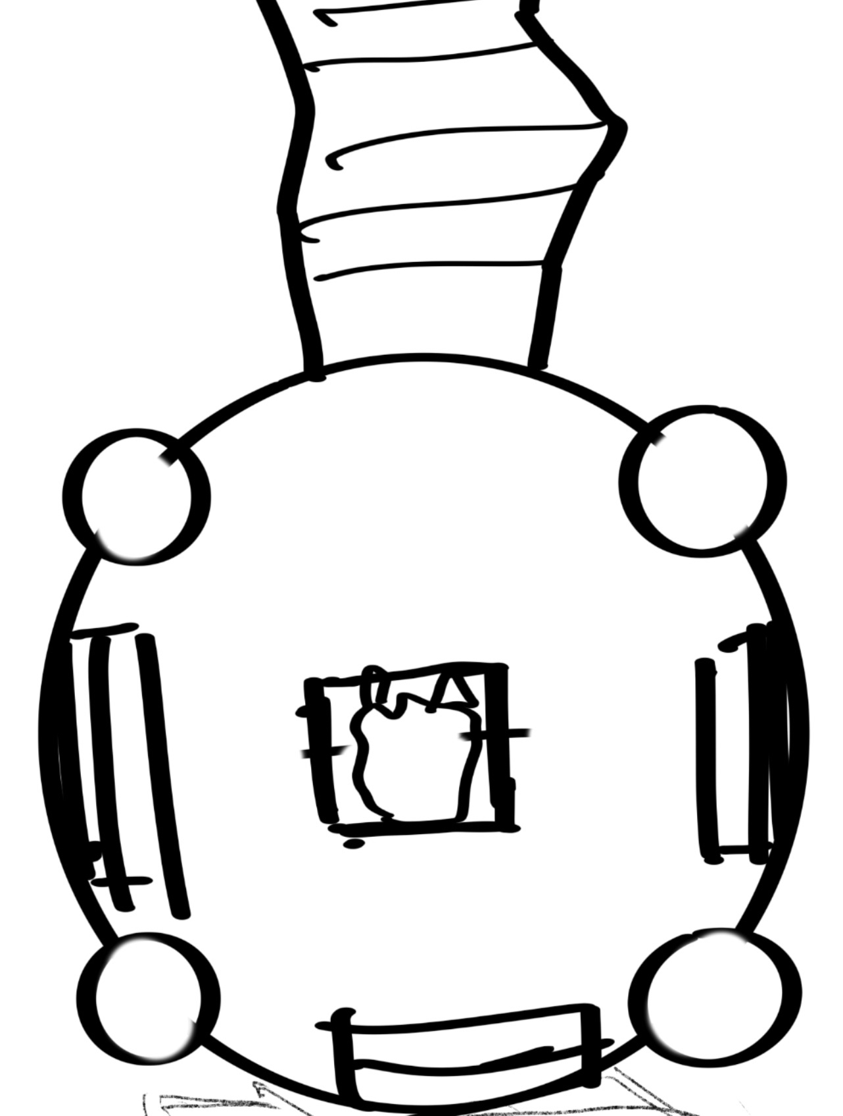
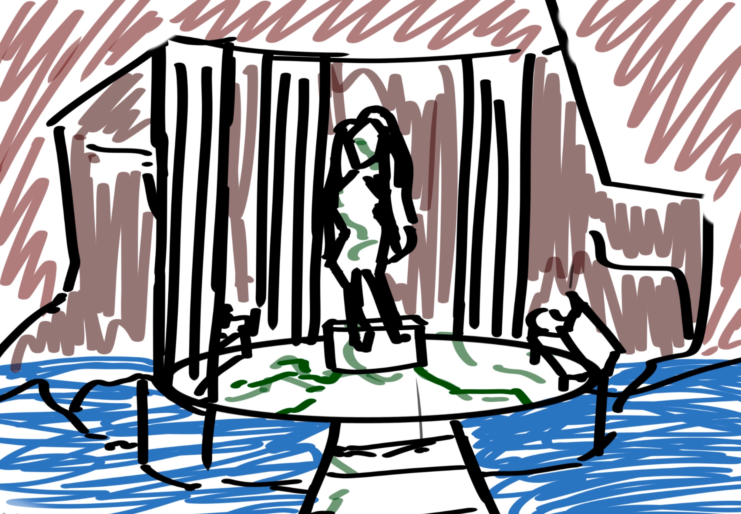
Scene Layout/Sketches
Notes:
Drawn layouts for your scene. Can be rough sketch, top-down map like, perspective/camera view or both.
Also write your reasoning.

Slide 8
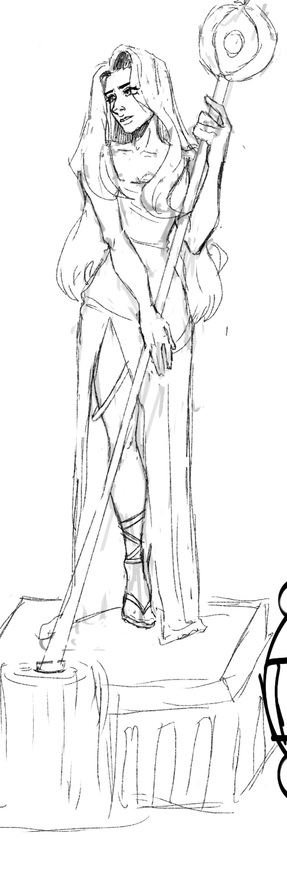
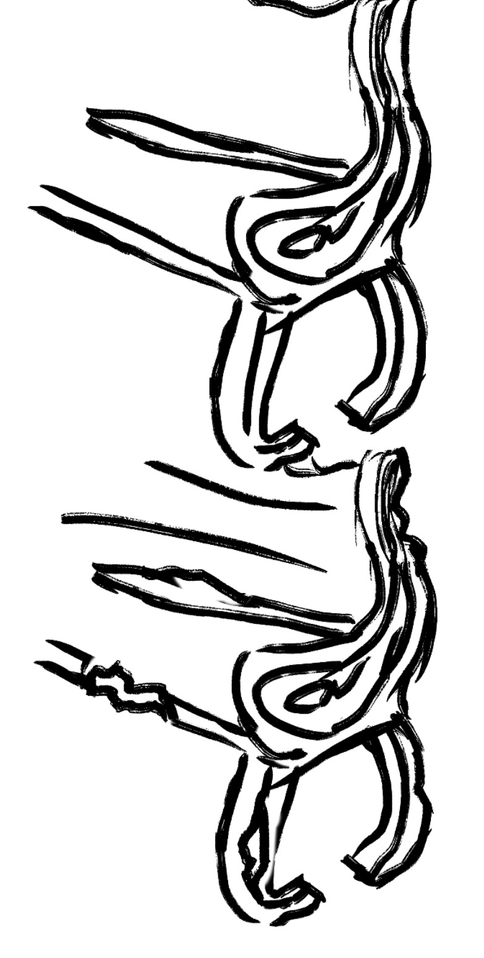
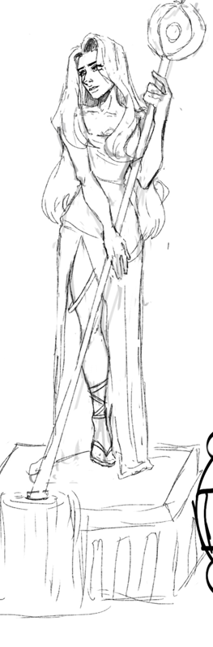
Prop Sketches
Notes:
Drawn layouts for your scene. Can be rough sketch, top-down map like, perspective/camera view or both.
Also write your reasoning.

Slide 9
Colour Palettes
Texture
Lighting
Notes:
Colour palettes for your scene. Also write your reasoning.
Good references: Color trends, stock, behance colors | Adobe Color

Slide 10
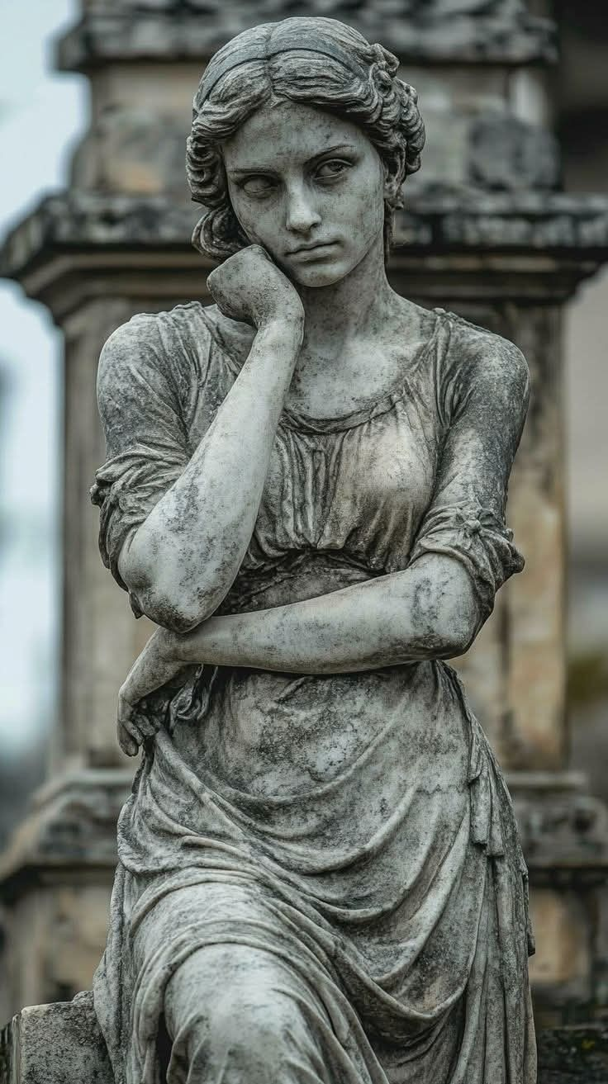
Prop List
Large Statue
Platform
Pillar 1
Pillar 2
Floor Tile
Round Tile
Bench
Bench 2
Stairs
Curved stairs
Staff
Gazebo Ceiling
Notes:
What models do you need to make for your scene?

Slide 11
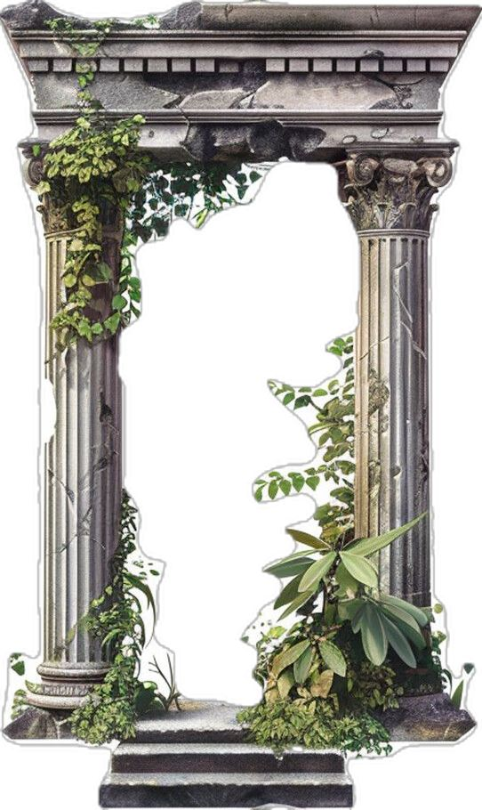
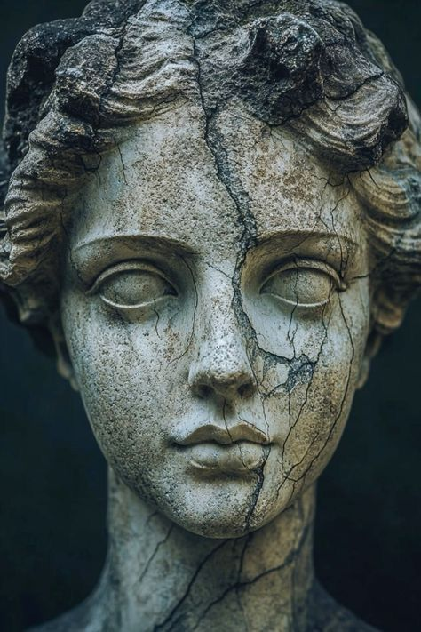

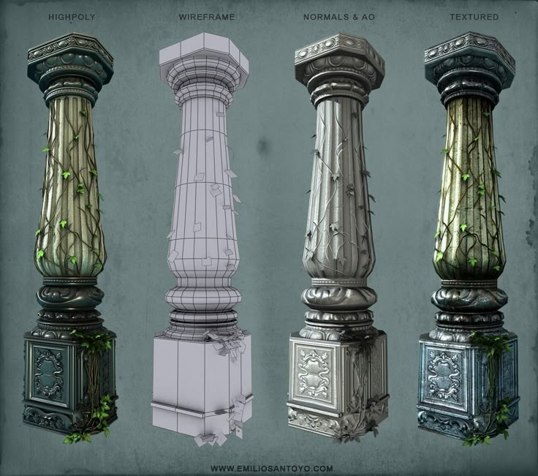
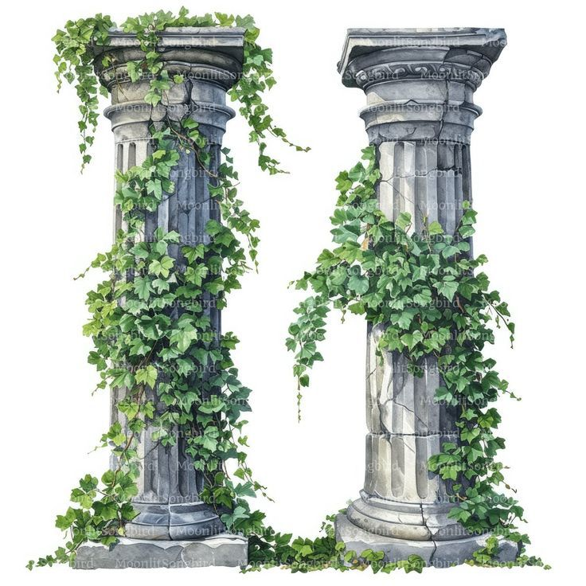
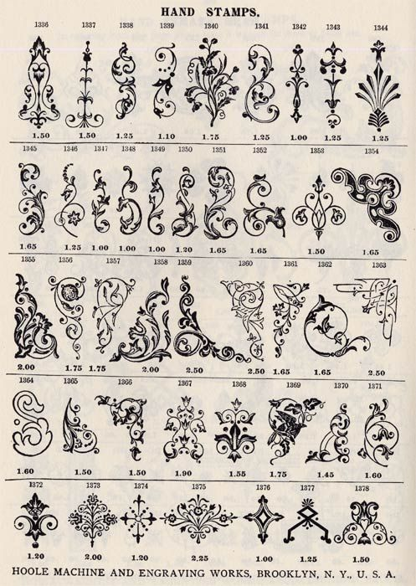
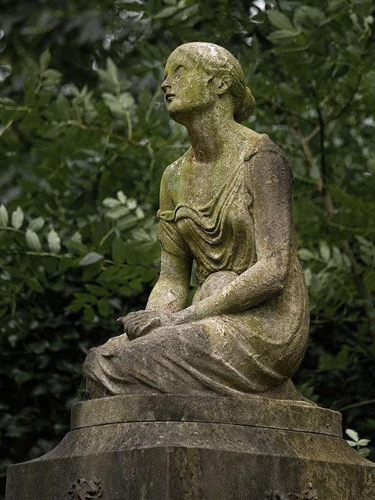
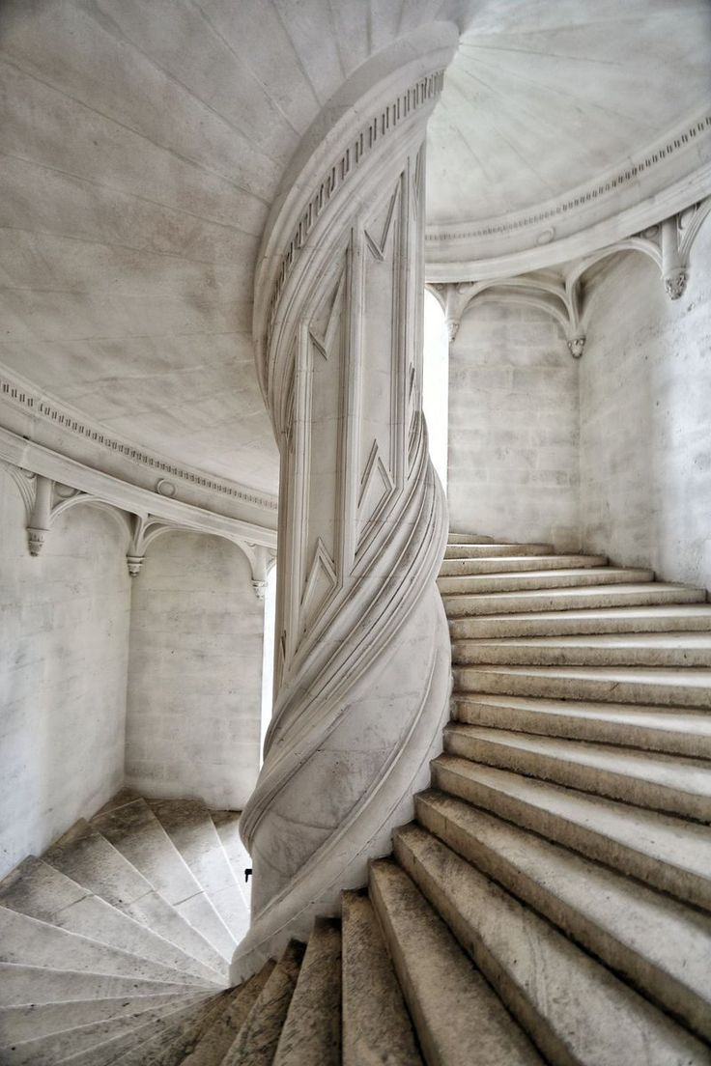
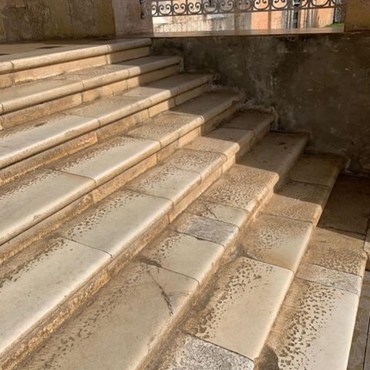
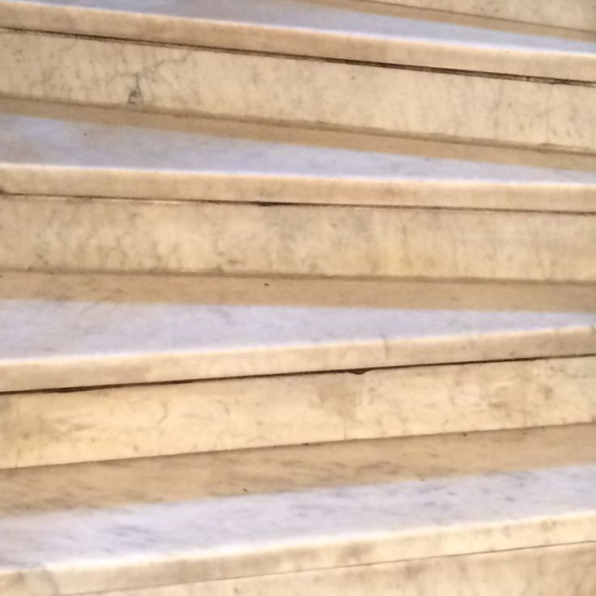
Texture Exploration
Notes:
Textures you find interesting and would work for your project. Also write your reasoning.

Slide 12
Progress
Update weekly

Slide 13
Scene Blockout
I have spent this week working on my hero model.
Notes:
Will fill out by week 7

Slide 14
Scene Progress Part 1
Notes:
Will fill out by week 8

Slide 15
Scene Progress Part 2
Notes:
Will fill out by week 9. Should be textured.

